Slide 1


NEW YORK CITI BIKE
Cece Li, Jackie Tang, Lucas Balsinde, Zhizhuo Li

Slide 2
Executive Summary
The rapid development of a bike-sharing company in New York City and its wealth of public datasets has drawn data professionals to address the user demand and resource allocation challenges. The available datasets open up the opportunity of deep geographical, time, and pricing analysis.
This analysis aims to help Citi Bike maximize profits by implementing an optimization-based framework. we will identify patterns to determine whether their current resource allocation and pricing is profit maximizing, and how they can gain market share in this competitive industry.

Slide 3
agenda
Executive Summary
Business Use Case
Data Sources / Tools
Dimensional Model
Data Preparation
Design Considerations
Data Loading
SQL Queries
Tableau Dashboard

Slide 4


Business Use case
Goal / Post Condition:
Help maximizing the operational profits by:
Drawing insights from Traffic volume and membership
Implementing an optimization-based framework
Main Flows:
Analyze the data
Analyze the business model
Consider the COVID risk as both a concern and an opportunity
Rebalance organizational resources
Adjust the pricing and resource allocation
Notes:
It is decomposed into several parts: analyzing their business model; rebalance the resources based on the market environment; how other transportation methods pose a COVID risk to their customers and how Citibike can take advantage of this.
Analyze data sources of CITI Bike, other forms of transportation and external factors
Consider the COVID risk as both a concern and an opportunity

Slide 5




Data Sources
Citi Bike System Data
Bus Stop locations
NYC Weather Data
NYC Health: COVID-19 Data
Notes:
Citi bike trip histories include trip duration, start time and date, stop time and date, start station name, end station name, user type, etc.
Geographical data about location of Bus Stops Shelters provided by NYC OpenData
Historical weather information for NYC, including temperature, precipitation, wind speeding, solar radiation and other detailed weather data accurate to every hour (Temperature, Humidity, Seasonality)
the most recent information the Health Department has collected about people who have tested positive for COVID-19 in NYC

Slide 6







Data & Tools
Clean, organize, and enhance
Prevent redundancies
Increase Efficiency and understandability
Data cleaning and wrangling
Merge and combine the datasets
Create a comprehensive database
Table relationship building
Analyze the business models
Come up with better solution for resource allocation
Visualize the results from data analysis
Create user-friendly dashboard for different audiences
Data Analysis and visualization
Notes:
Predicting the demand through historical vehicle records combined with other factors such as date, weather, temperature , humidity using Correlation matrix and Random Forest model in data manipulation (with Pandas) and map visualizations (with Folium) in Python to determine which factor affects the ridership most and plot how each factor impacts demand.
Data cleaning and wrangling
We will clean, organize, and enhance the raw data before making the database, preventing future data issues, increasing efficiency by getting rid of redundancies, and making easier to work with.
Table relationship building
We will merge and combine the datasets to create a comprehensive database which includes the relationships between the different datasets.
Data Analysis and visualization
Next, we are planning to analyze the comprehensive database with several business models and comes up with suggesting better solution for resource allocation and visualize the results from data analysis and create user-friendly dashboard especially for non-technical business audiences and extract some insights.

Slide 7

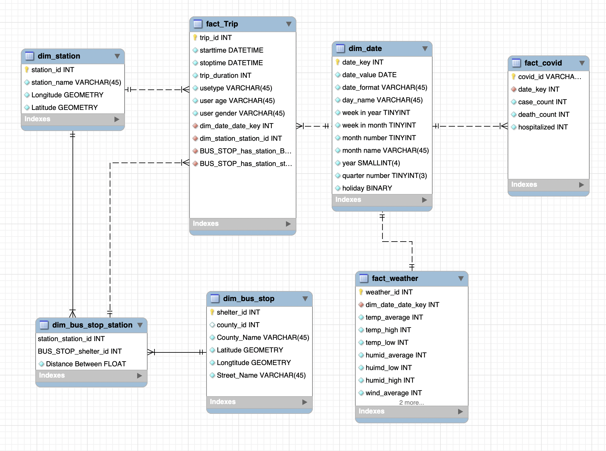
Dimensional model
1
1

Slide 8
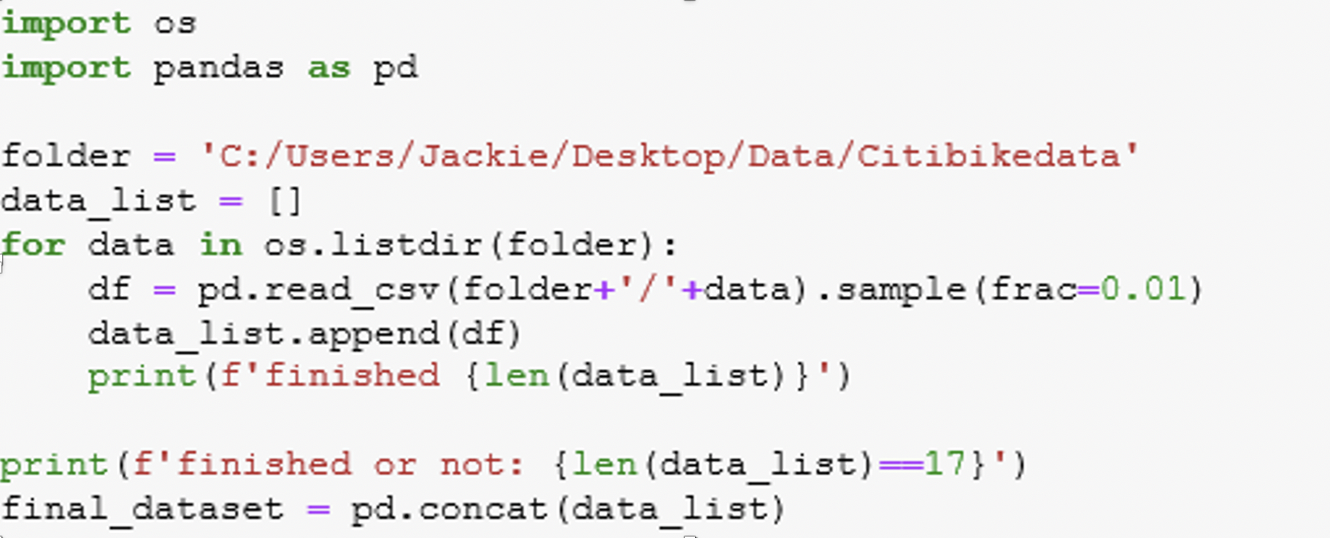
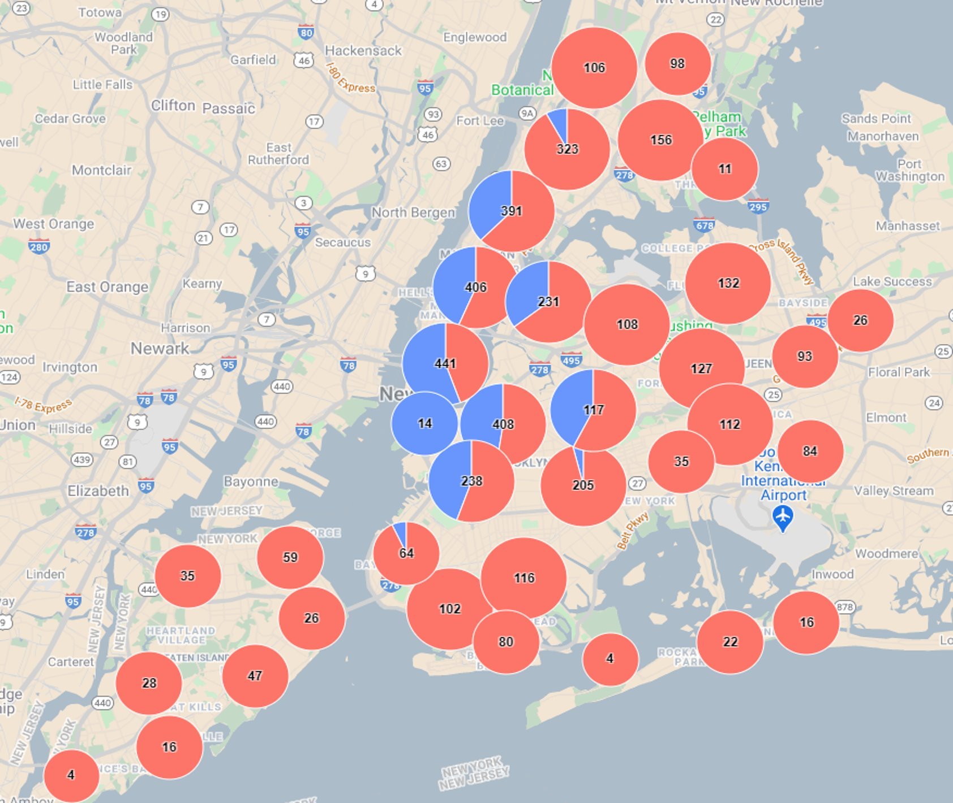
Data Preparation
Data Sampling
Randomly select 0.1% of 40 million rows
1.5 years
Data Cleaning
Fill missing values
Remove the unrelated data columns
Split and format the columns
Data Structure & Organization
Unified format to SQL analytics uses
Notes:
Data – part of web scraping / part of downloading
Data sampling – python
Randomly select 1% data from 40 million rows dataset by using Python
We are collecting the citi bike data for 1 and half year long, we sample a smaller data set from a very large data set
Data cleaning – open refine / API by google cloud
Fill missing values in python and inconsistent entries are harmonized
Remove the unrelated data columns
Split and format the columns (Open Refine)
All Geocode column in both bus station and citibike was split into two column without marks in order to further reverse geocoding.
All location was split into three column : Boro, Street and State in corresponding the geocode
Data organization
Unified format to meet requirements of the planned SQL analytics uses
Add trip duration column in citibike data
Formatting all time column into one unique format in all tables

Slide 9
Platform Considerations
OLAP / Dimensional Model
Google Cloud
Multiple fact tables
fact_Trip
fact_covid
fact_weather
Dimension tables
Dim_bus_stop / Dim_station / Dim_bus_stop_station
Dim_date / Dim_time
Dim_date connects to three fact tables - fact_trip, fact_weather, and fact_covid
Notes:
OLAP / dimensional – better for reporting and analysis
Rather than processing real-time data from transactions, our project aggregated historical data from OLTP, and focus on deriving information from data.Dimensional Model
allows us to build up a clear data model with dimension tables being further extended
Google Cloud
By using Cloud Api, we are able to retrieve the exact location based on the geocode
Multiple fact tables
fact_Trip table contains data aggregated from CitiBike open data, which records the start time, stop time, user type, user age, user gender of each trip. Foreign keys are included for connection with dimension tables
fact_covid tables include the case count, death count and other information for each distinct date from February 2020 to November 2020
fact_weather tables include the average/high/low of temperature, humidity, and wind speed per day.
Dimension tables
Dim_bus_stop and dis_station store information about other kinds of transportation
Dim_data and dim_time are date and datetime data needed in analysis
Dim_date connects to three fact tables - fact_trip, fact_weather, and fact_covid – which store information about trip data, weather condition and covid cases in the NYC respectively.

Slide 10
Other Design Considerations
The use of multiple fact tables:
Weather and covid data contain measures rather than categorical variables
Unique id of fact_weather and fact_covid
Dimensional model vs ER model:
The data contain lots of historical data
Standard framework and easier for user to understand
Being able to accommodate unexpected new data elements and design changes.
Notes:
The use of multiple fact tables:
Although fact_trip is our mean focus, but the weather and covid data contain measures rather than categorical variables, so we decided to use more than one fact table and connect them with dim_date.
Although the date attribute of fact_weather and fact_covid are both unique, they are better to have another unique id for more convenient future data queries
Dimensional model vs ER model:
The data contain lots of historical data
Standard framework and easier for user to understand
Being able to accommodate unexpected new data elements and design changes.

Slide 11
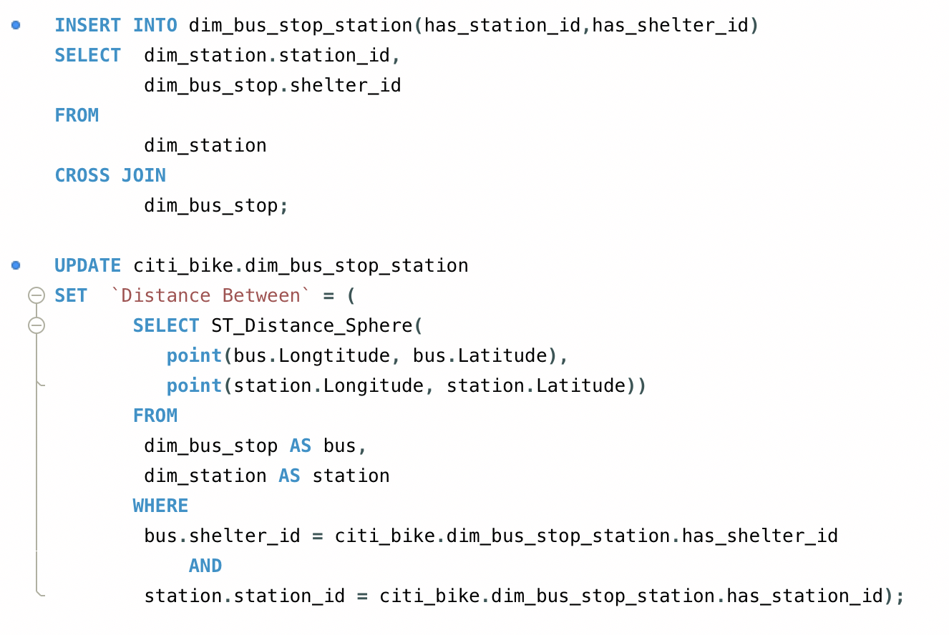
Loading Data & Calculations
Loading data
Mainly Import directly
Fix the data format
The order of importing based on dependency
Dimension tables vs. Fact table
Dim bus_stop_station
The joint table between bus stop and Citi bike station
Insert shelter id (bus stop) and station id (citi_bike)
Set default values for distance as NULL initially
Use function to calculate the distance
Notes:
Loading data
Mainly Import directly
Fix the data format
The order of importing based on dependency
Dimension tables vs. Fact table
Dim bus_stop_station
The joint table between bus stop and Citi bike station
Insert shelter id (bus stop) and station id (citi_bike)
Set default values for distance as NULL initially
Use function to calculate the distance

Slide 12

MySQL Queries

Slide 13
I. Factors affect trips of citi bike (weather and covid)

Slide 14


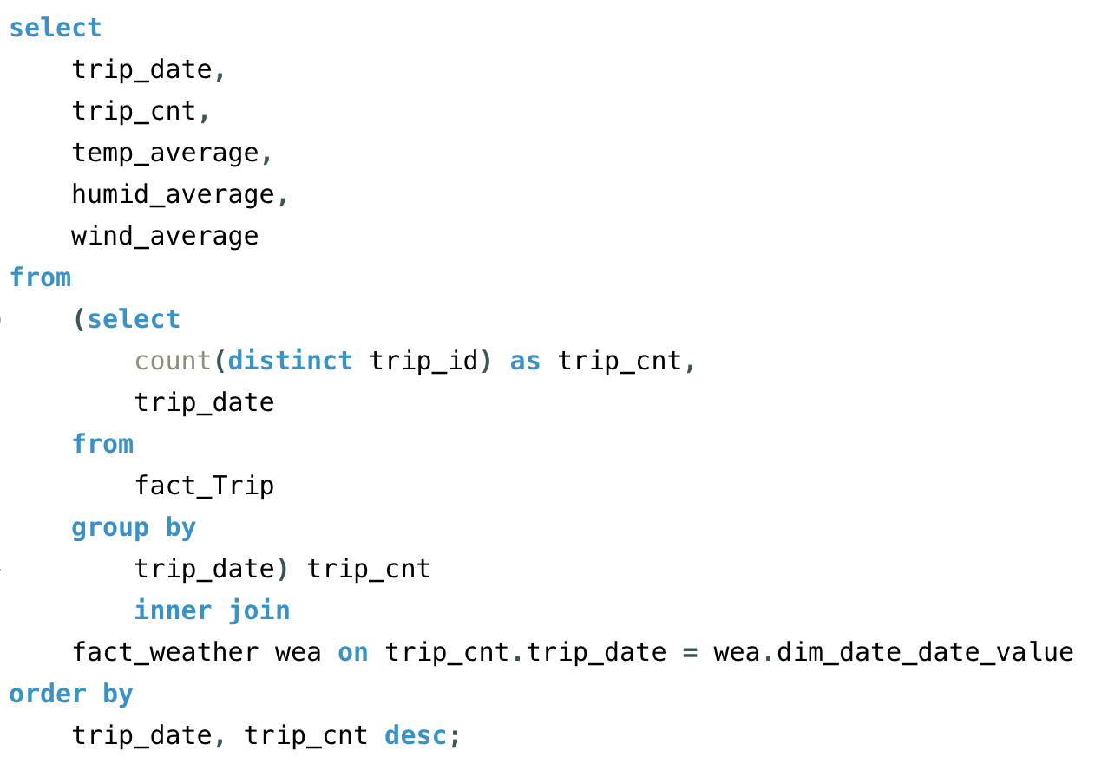
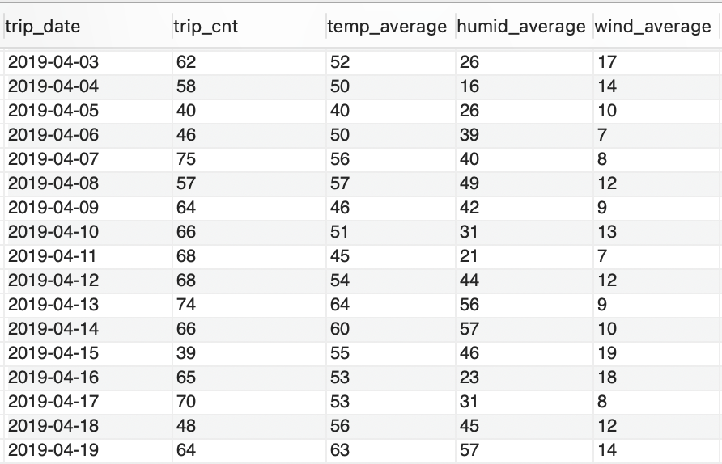
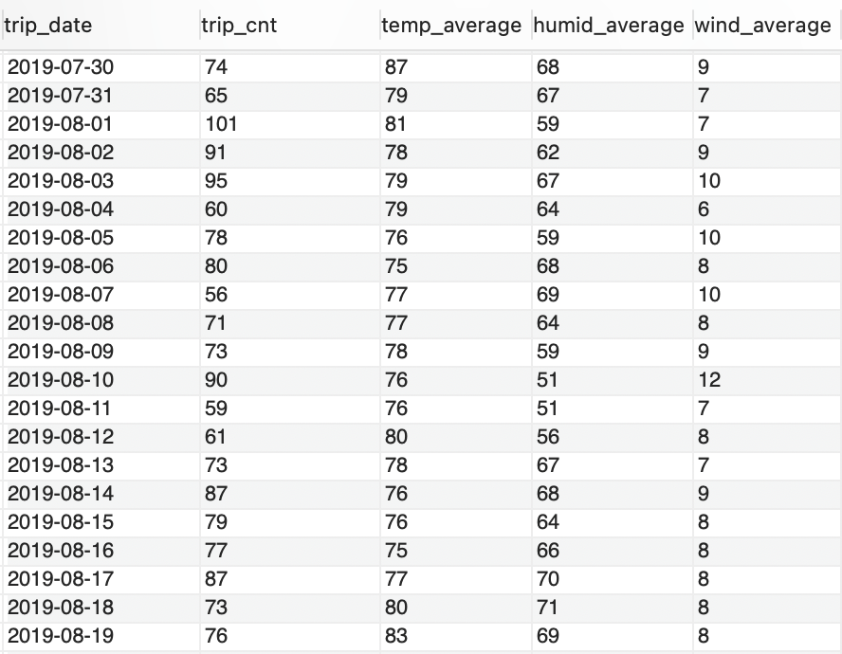
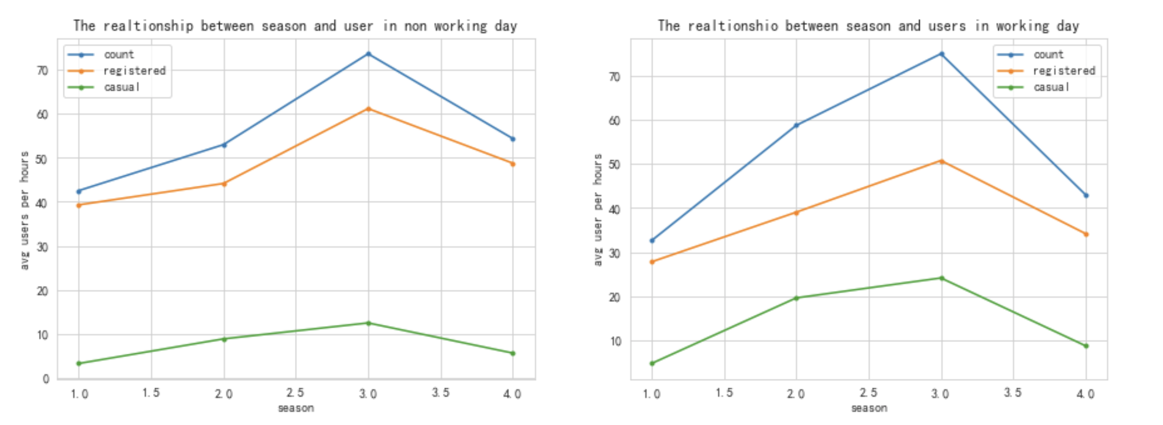
Weather & citi bike
Spring
Summer

Slide 15
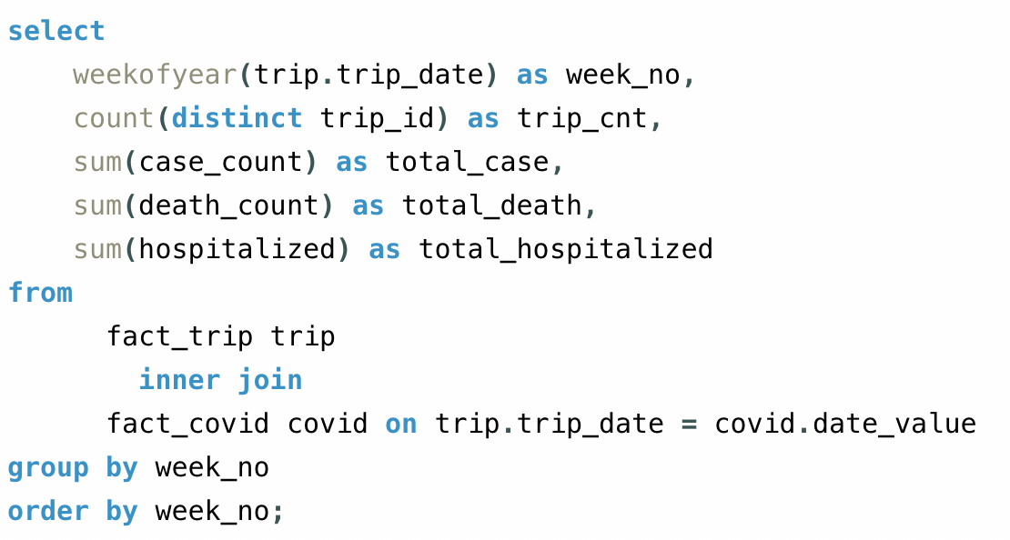
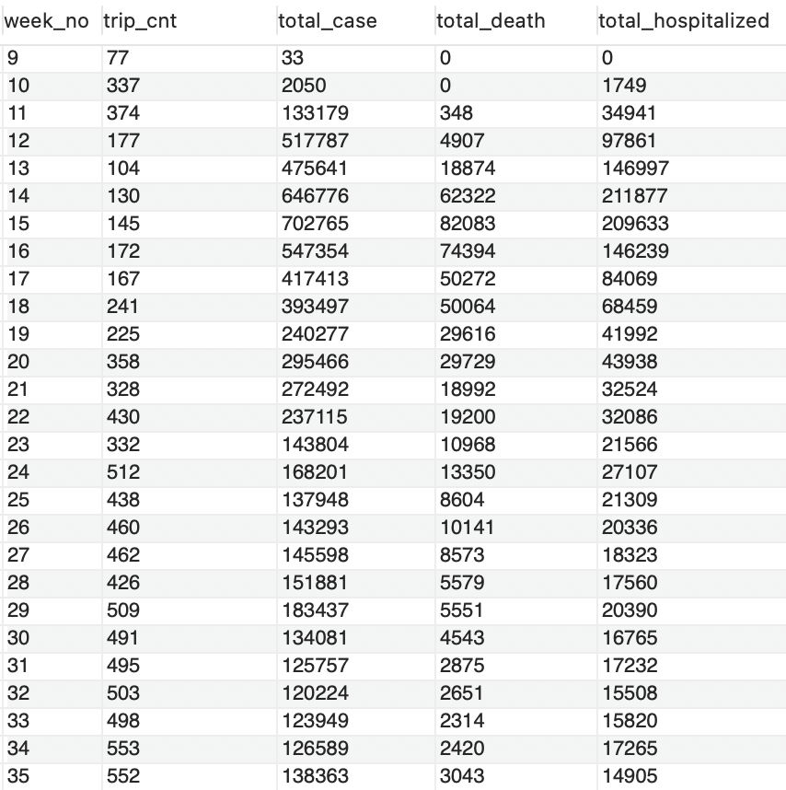

Covid & citi bike

Slide 16

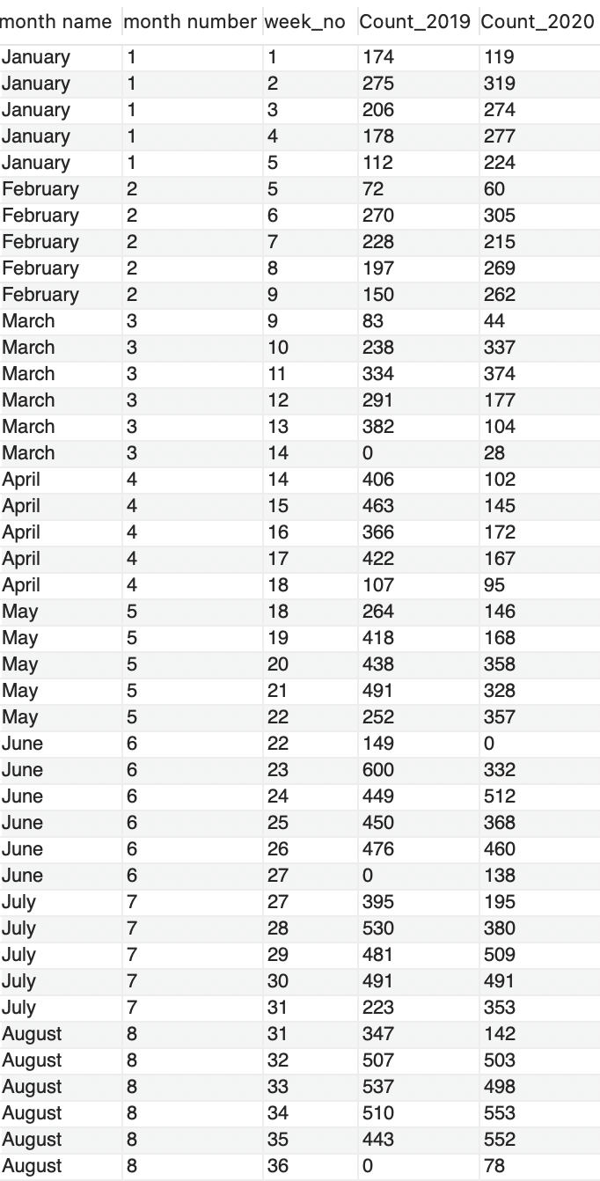
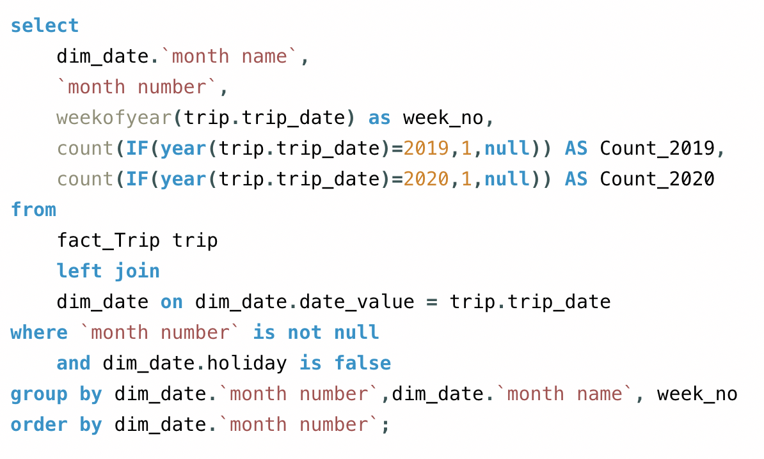
Compare trip counts in 2019 vs 2020

Slide 17
II. Trip pattern and user analysis

Slide 18
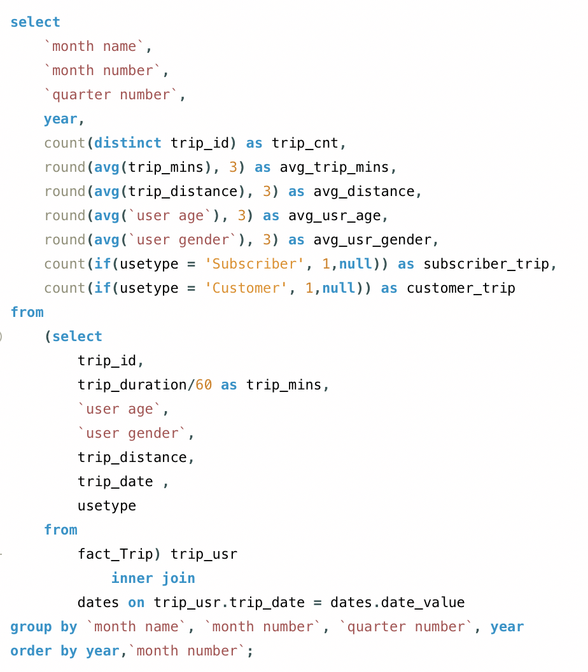
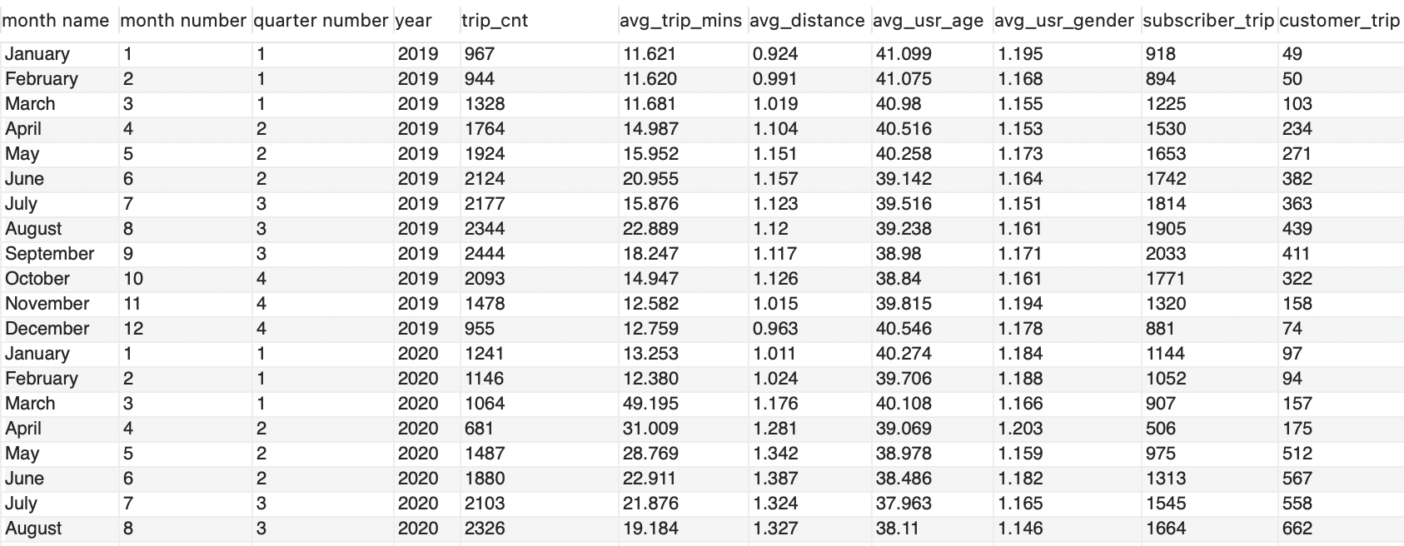
Basic information about citi bike trips & user profile in each month

Slide 19
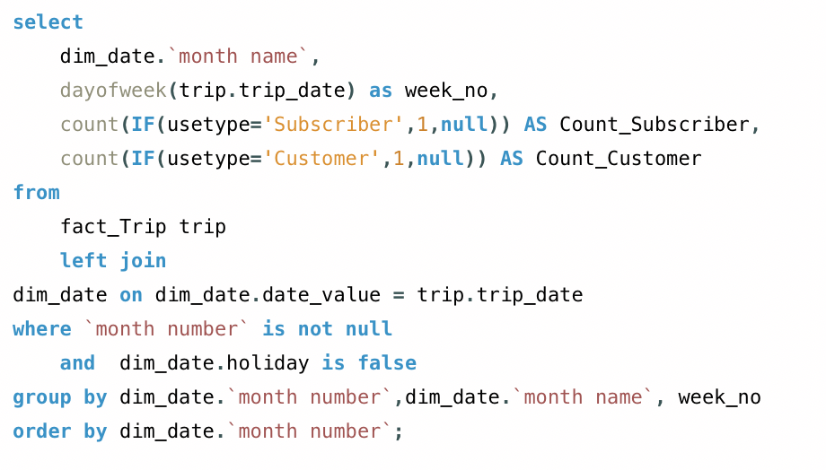
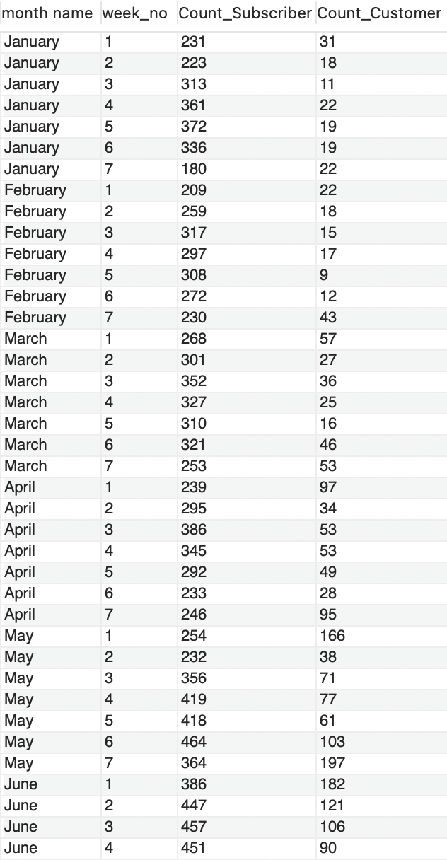
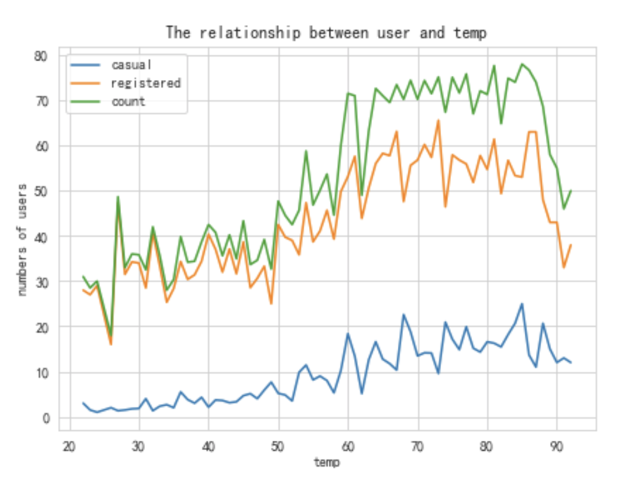
Customer vs subscriber

Slide 20
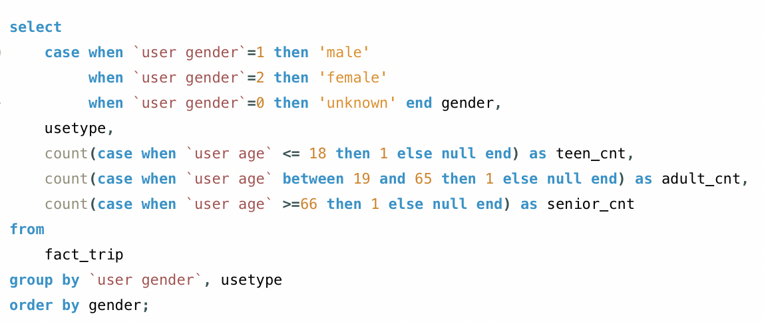
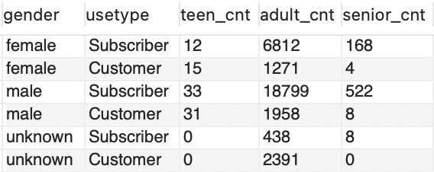
Users INFO

Slide 21
III. Comparison of trips in weekdays and weekends

Slide 22
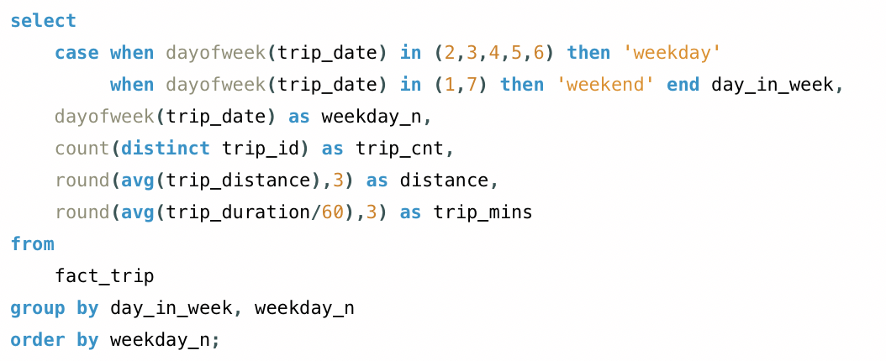

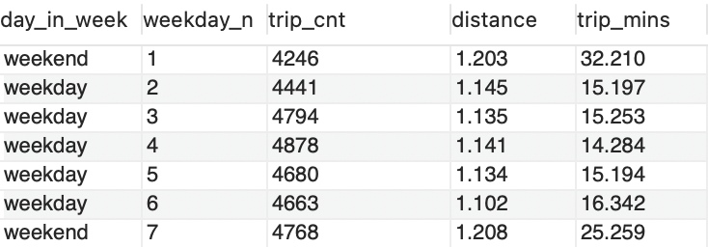

weekdays vs weekends
Trip Count

Slide 23
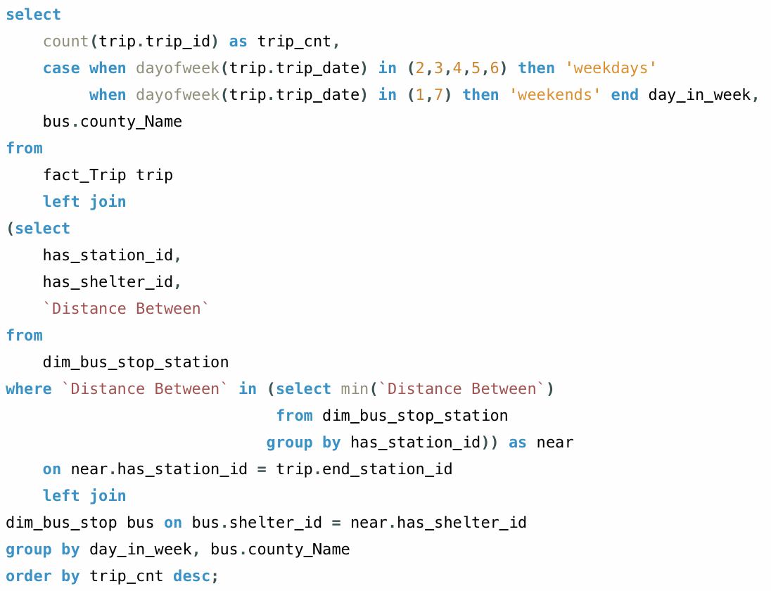
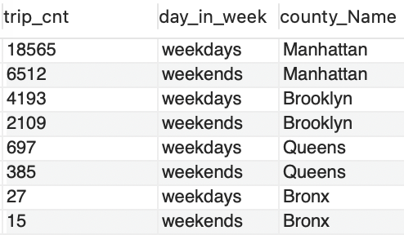
Compare destination of trips on weekdays and weekends
weekdays vs weekends
Destination

Slide 24
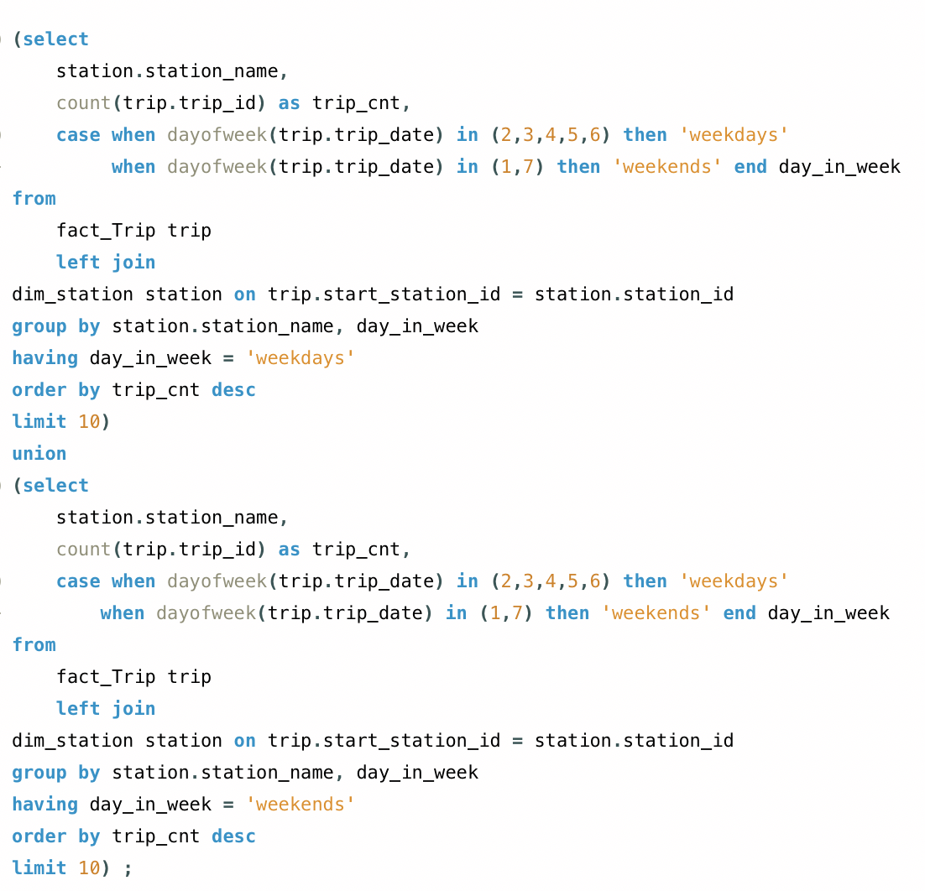
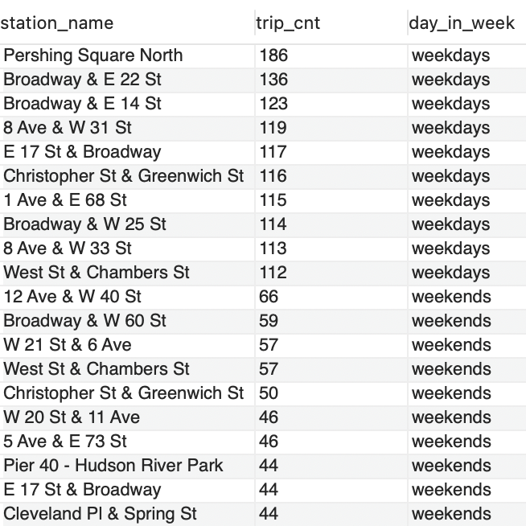
Top 10 popular start stations on weekdays and weekends

Slide 25
Tableau Dashboard

Slide 26
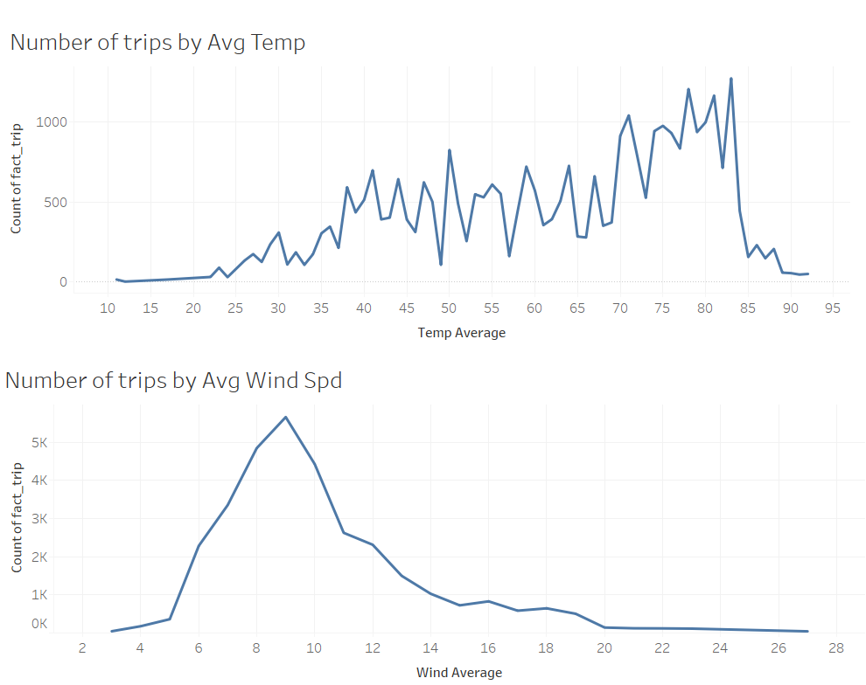
Ridership patterns pre-Covid
We want to find the conditions in which bikes are most highly demanded

Slide 27
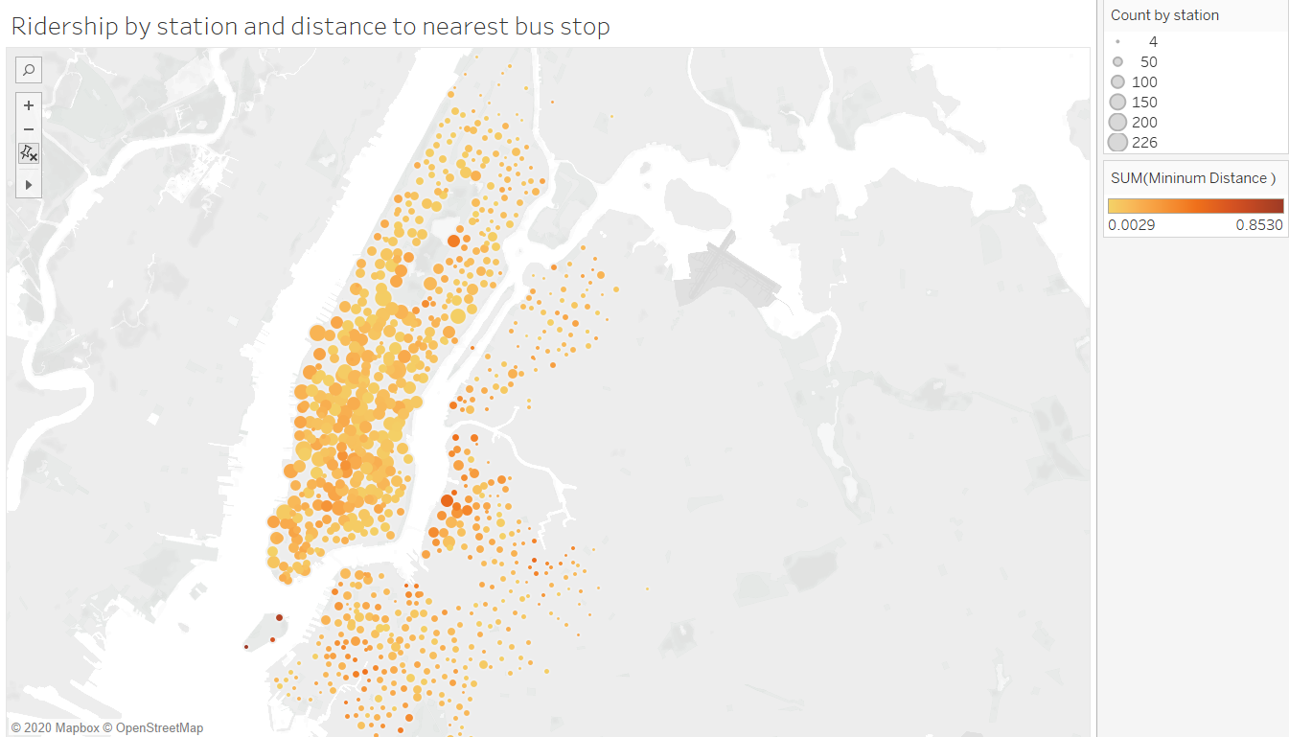

Slide 28
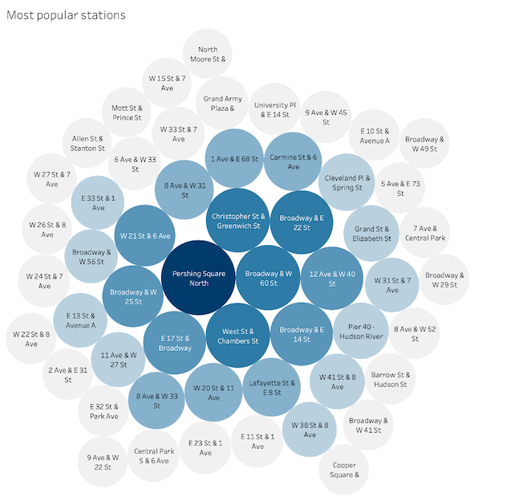
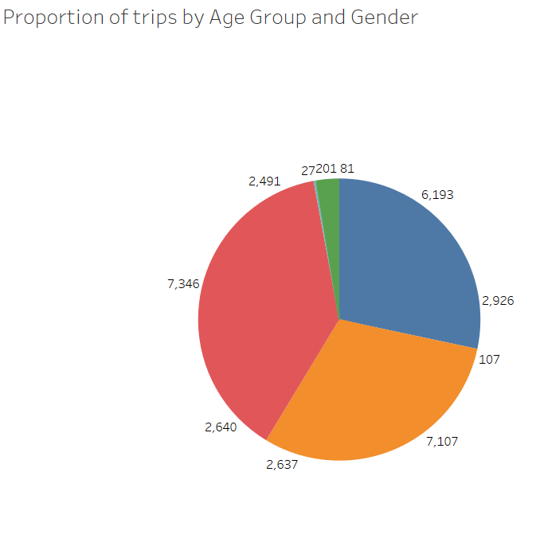
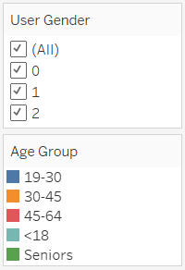

Slide 29
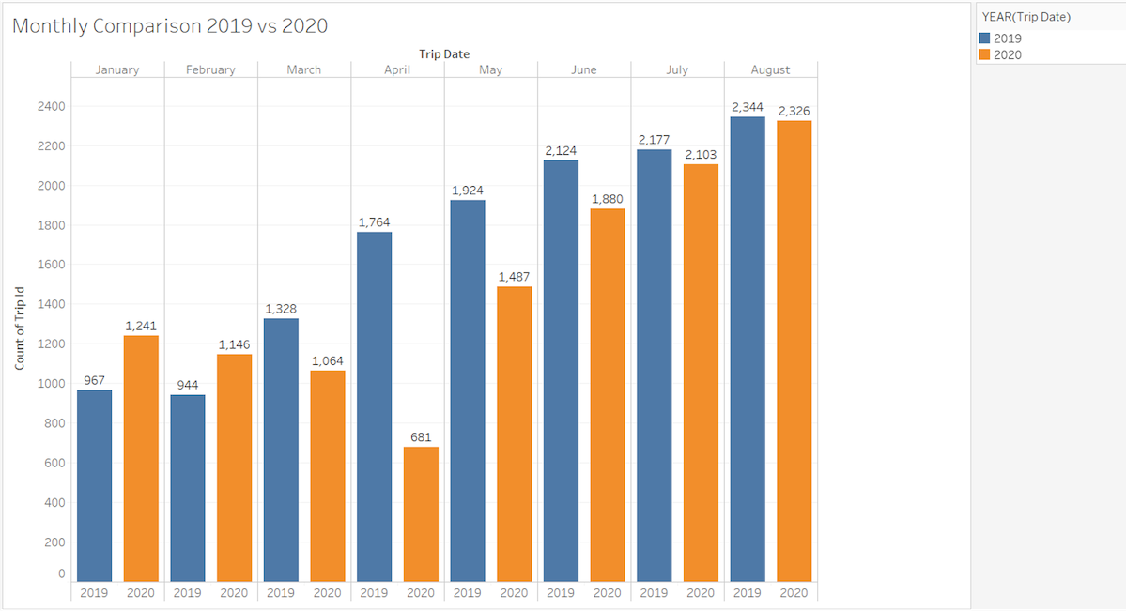

Slide 30
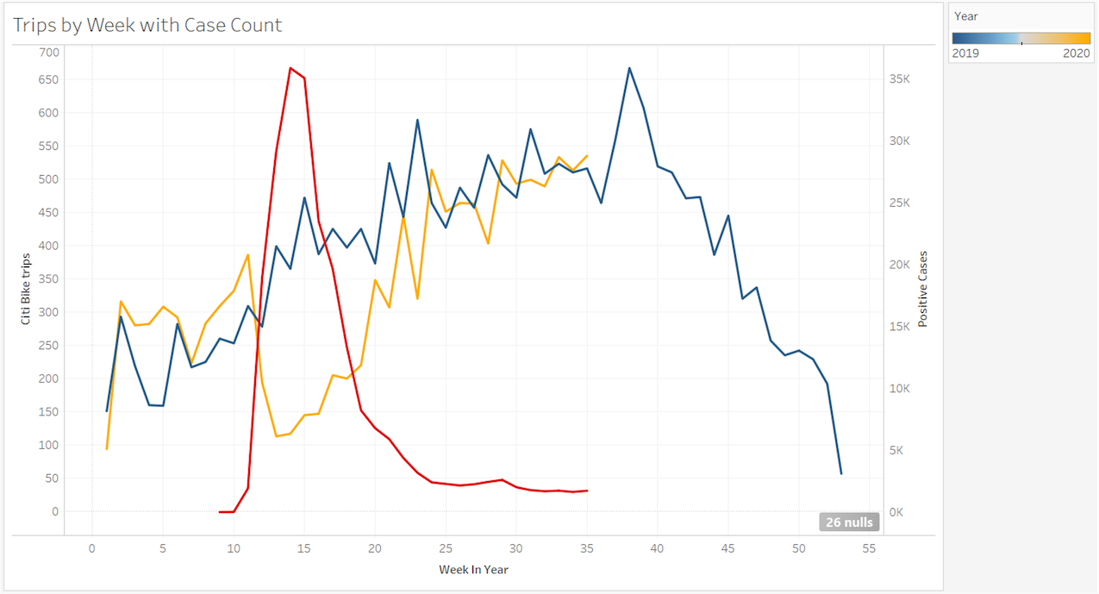

Slide 31
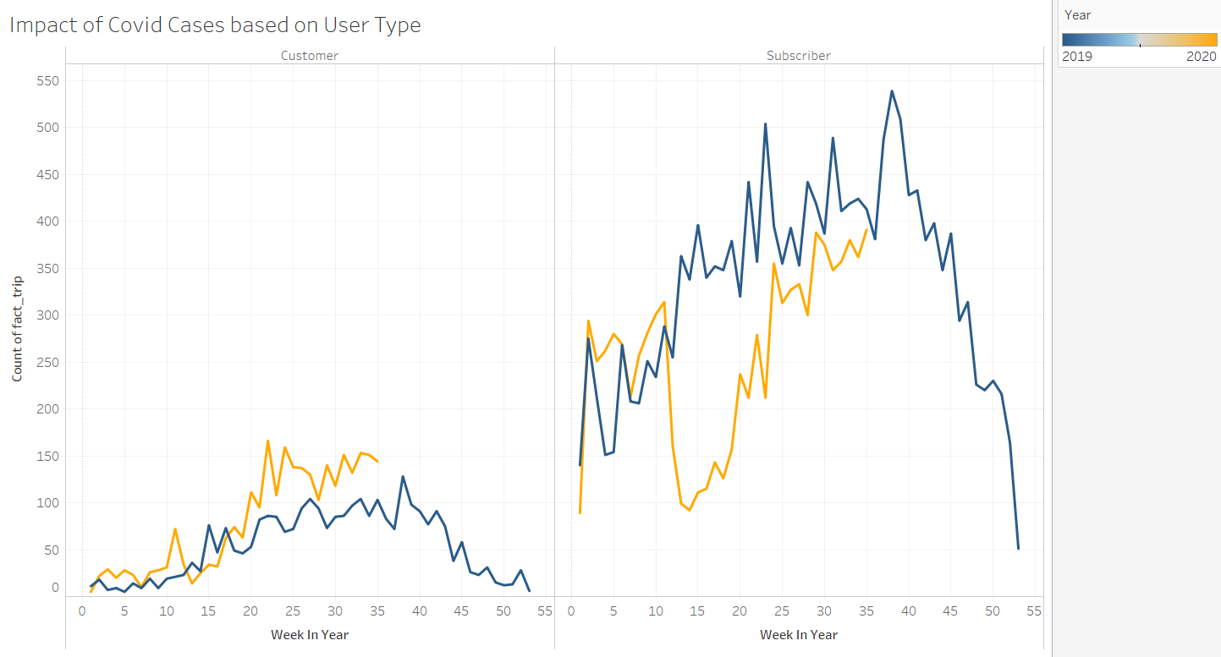

Slide 32
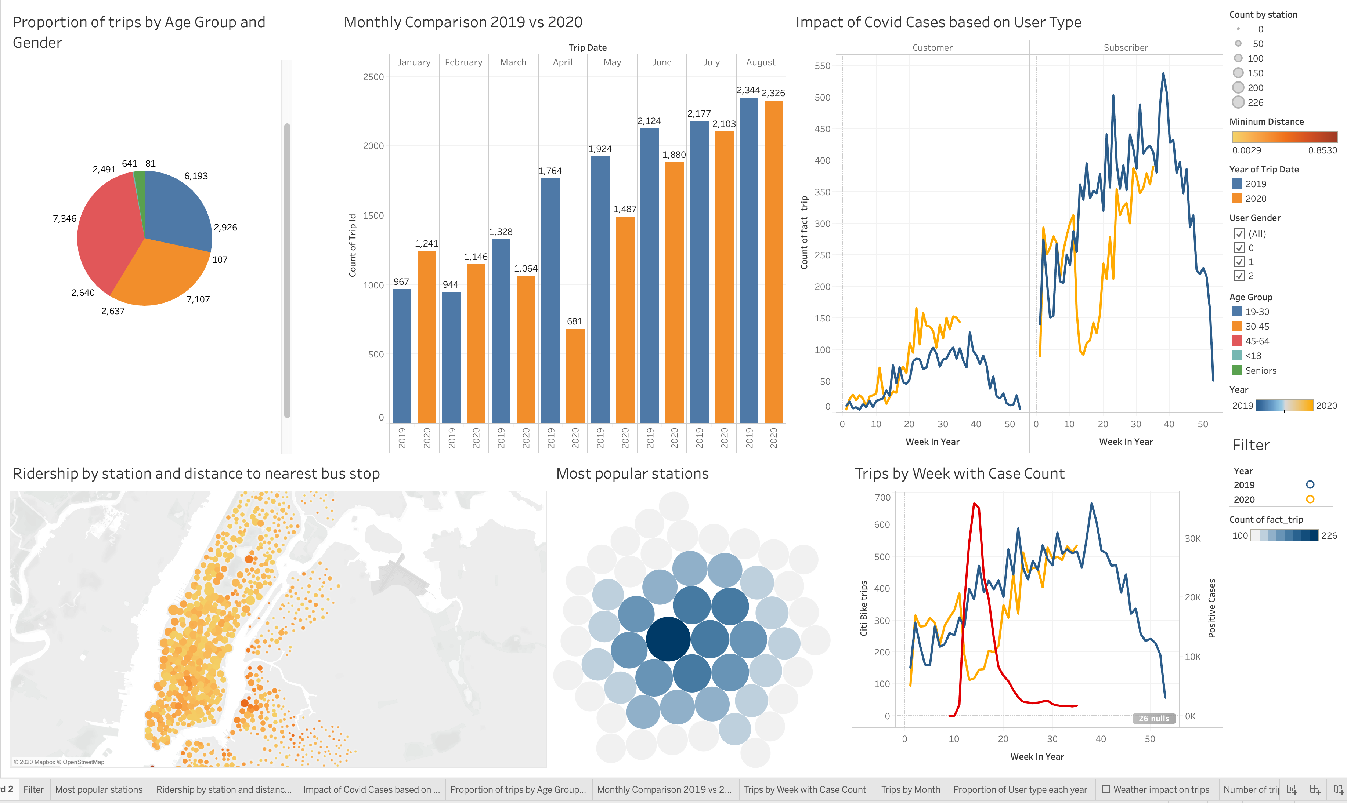

Slide 33
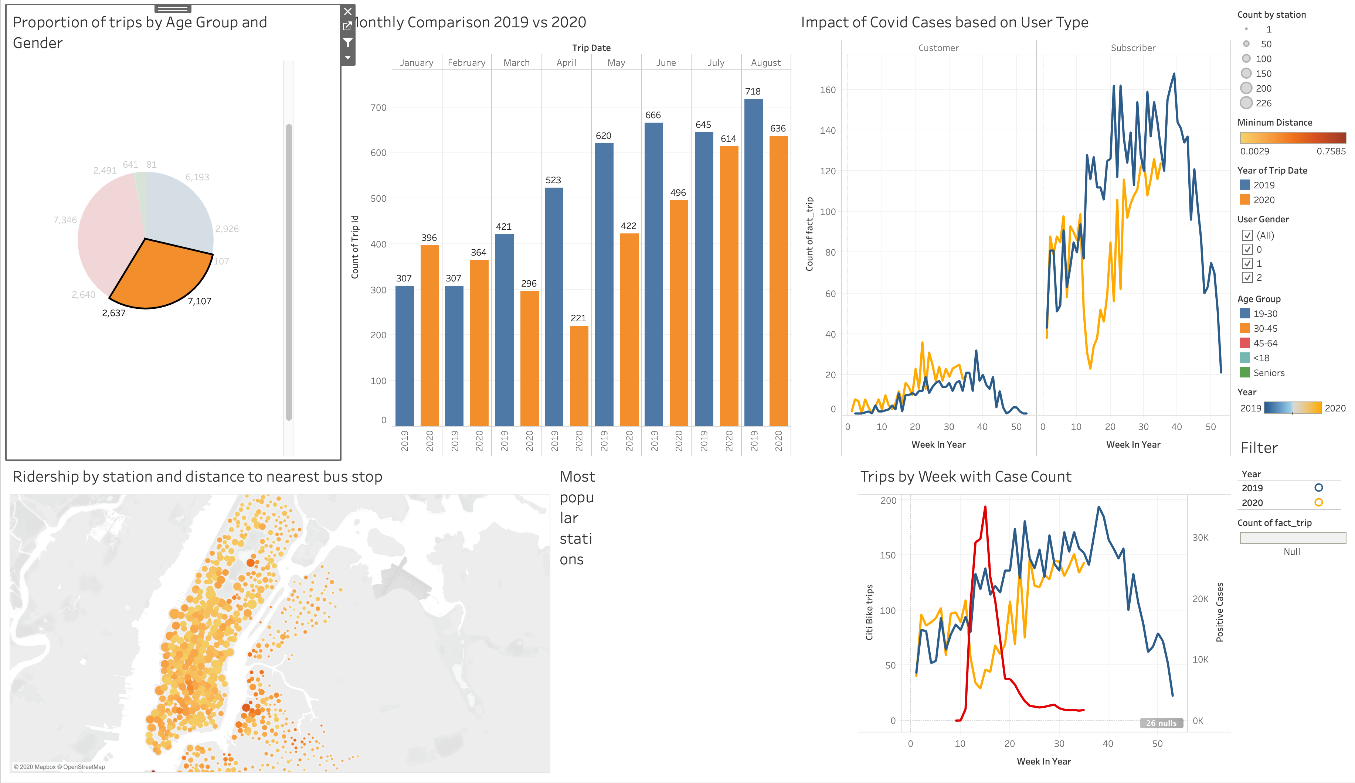

Slide 34
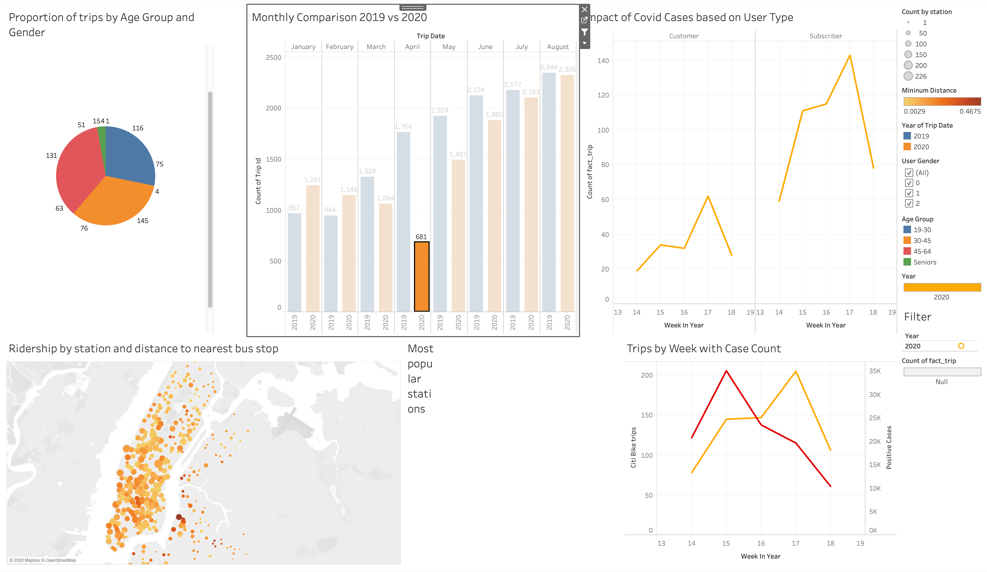

Slide 35
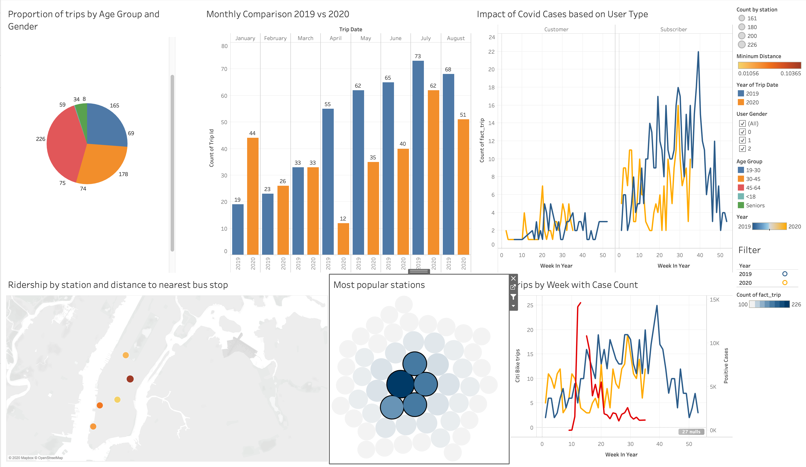

Slide 36

Recommendations
1
Marketing campaign strategy:
Customer (non-subscriber)
Subscriber
Marketing campaign highlighting the benefits of Citi bikes over other transportation methods during the pandemic
Price surging during optimal weather conditions
Lower prices for bike trips ending in highly demanded stations
Potential Improvements and Future Exploration
Add more public transportation data
Explore the frequency of rentals through the day
Include more data on three fact tables

Slide 37
Thank you!

Slide 38
Data Sources
https://www.citibikenyc.com/system-data
https://data.cityofnewyork.us/Transportation/Bus-Stop-Shelters/qafz-7myz
https://www.meteoblue.com/en/weather/archive/export/new-york_united-states-of-america_5128581
https://www1.nyc.gov/site/doh/covid/covid-19-data.page

Slide 39
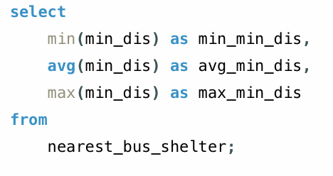
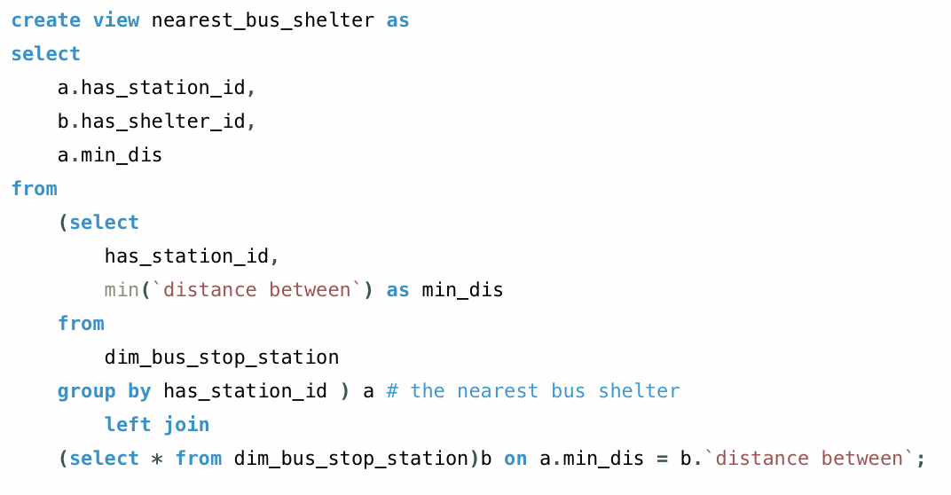
appendix

Slide 40
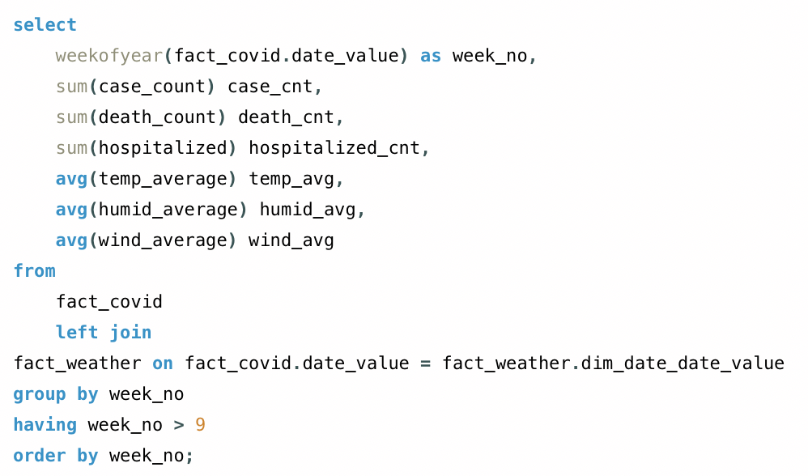
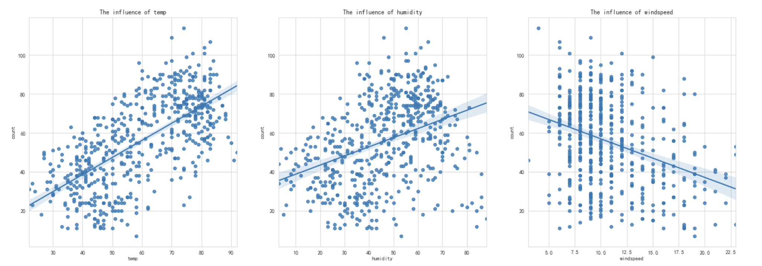
appendix

Slide 41
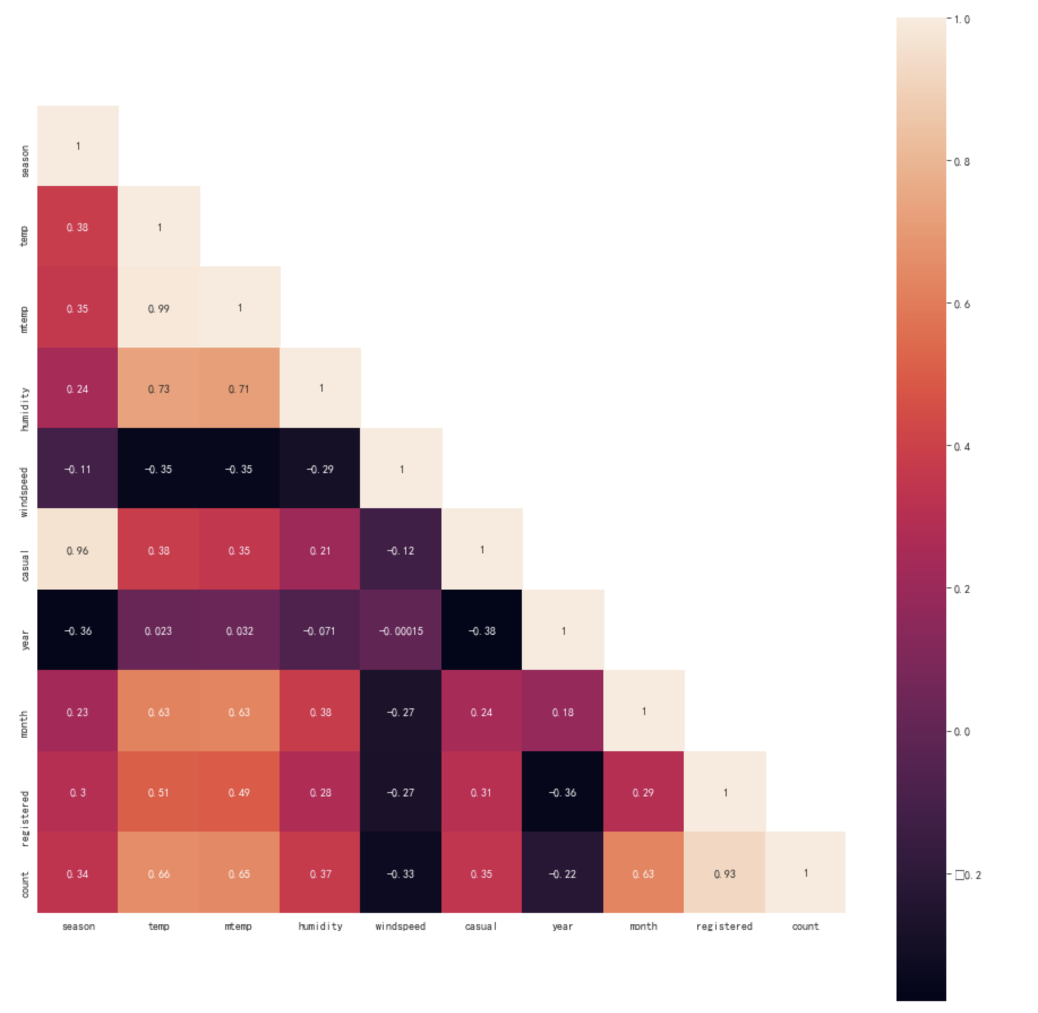
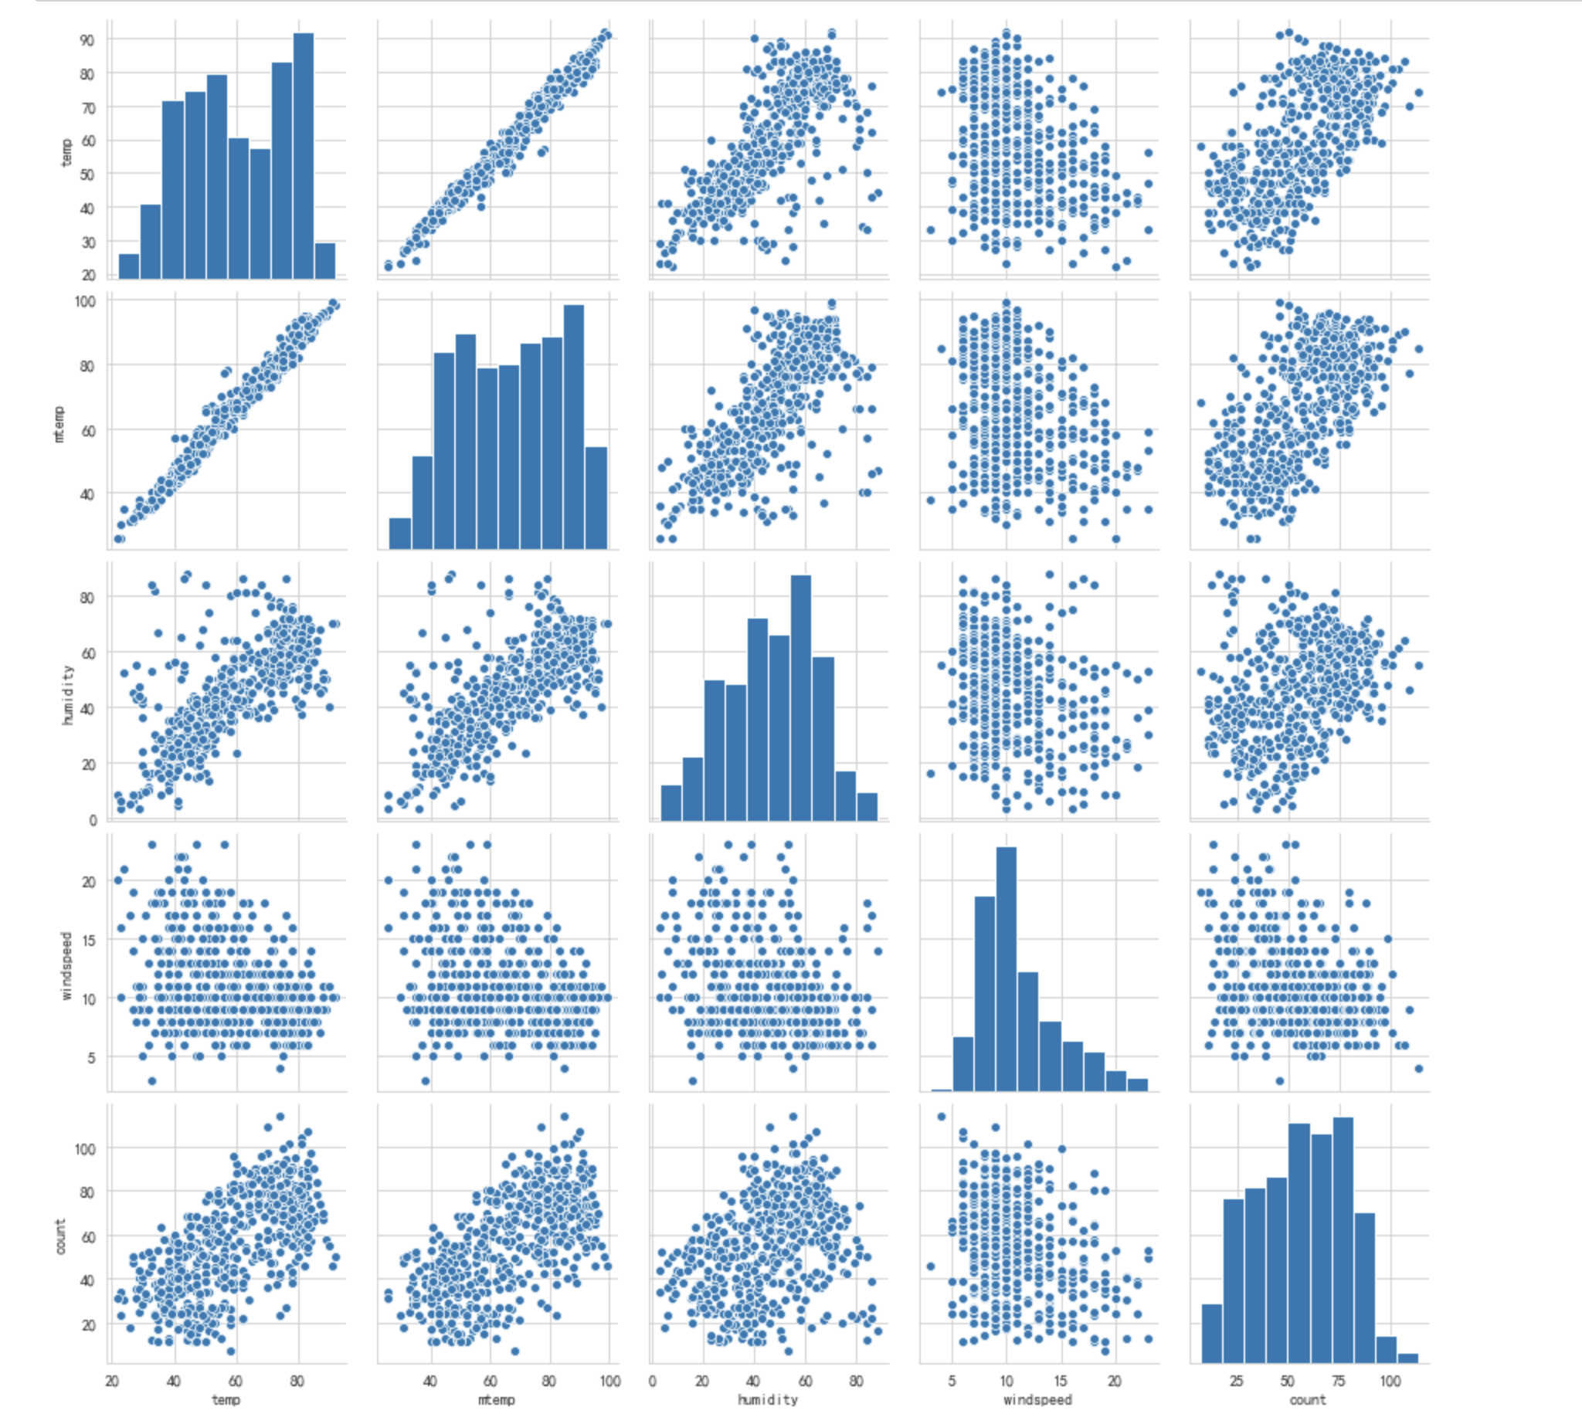
appendix

